Slide 1
Chapter 15
The Judiciary
American Democracy Now, 7th edition
Brigid Callahan Harrison
Jean Wahl Harris
Michelle D. Deardorff
Copyright 2022 © McGraw Hill LLC. All rights reserved. No reproduction or distribution without the prior written consent of McGraw Hill LLC.

Slide 2
What Do Courts Do? 1
One characteristic of dual sovereignty in the United States is that the national government establishes national law, and each state government establishes its own state laws.
Another characteristic is the dual court system.
Each state has a judicial system responsible for resolving legal disputes over the state’s laws.
Federal judicial system is responsible for resolving legal disputes over national laws.

Slide 3
What Do Courts Do? 2
Unlike the legislative and executive branches, the judicial branch is reactive—judges must wait for someone to file a lawsuit before they can do their work.
Judges do not have constituents to represent.
Judges are responsible for resolving disputes over whether accused persons have harmed society or another person by their actions or inactions, as well as determining the constitutionality of laws and their applications.

Slide 4
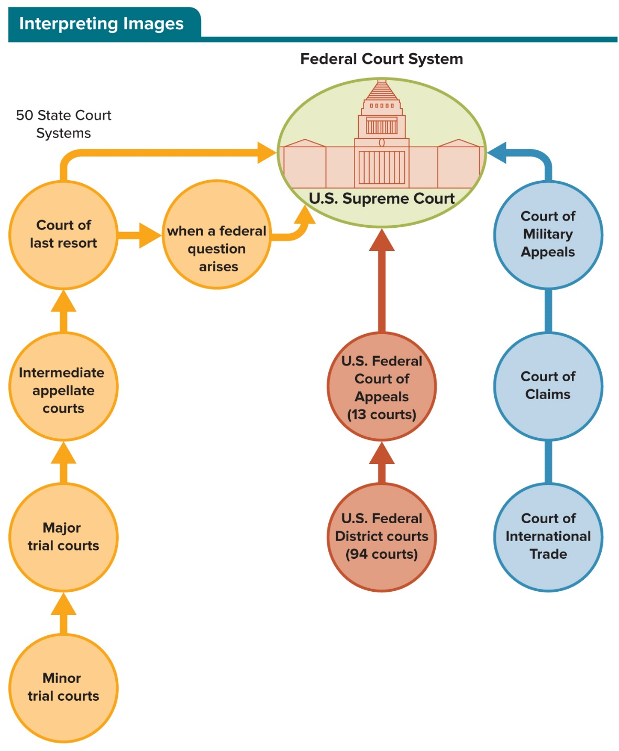
Figure 15.1 Jurisdiction in the Dual Court System
In the dual court system, the cases that state courts have authority to hear differ from those that the federal courts have authority to hear. One twist is that a lawsuit that began in a state court can end up in the federal court system.
Access the text alternative to slide image.

Slide 5
Sources of Law in the United States
Law is a body of rules established by government officials that binds governments, individuals, and nongovernment organizations.
There is a variety of sources of law in the United States, including constitutions, pieces of legislation, executive orders, rules and regulations made by administrative bodies, and judicial decisions.

Slide 6
Judicial Decisions: Common Law
Common law is judge-made law grounded in tradition and previous judicial decisions.
Doctrine of stare decisis directs judges to identify previously decided cases with similar facts and apply the rule of law used by the courts in the earlier cases.
Judges have the discretion to ignore a precedent if there are contradictory precedents or if they believe the earlier decision was wrong.
Previous cases with similar facts identified by judges are precedent cases.

Slide 7
Constitutions: Constitutional Law
U.S. Constitution is the supreme law of the land.
In cases concerning the U.S. Constitution, the highest court is the U.S. Supreme Court.
Body of law that comes out of the courts in cases involving constitutional interpretation is known as constitutional law.
Courts regularly have to resolve disputes over the proper balance between the common good and individual civil rights and liberties.

Slide 8
Legislation: Statutes
Laws written by legislatures are called legislation, acts, and statutes.
U.S. Code is a compilation of all the laws ever passed by the U.S. Congress, and it reflects that body’s priorities and concerns.
Each state has a penal code, which is a compilation of all its criminal law.

Slide 9
Executive Orders
Article II, Section 1, of the U.S. Constitution states that “the executive power shall be vested in [the] president of the United States.”
This power has been interpreted as allowing the president to issue orders that create and guide the bureaucracy in implementing policy.

Slide 10
Administrative Rules and Regulations: Administrative Law
In the lawmaking process known as administrative rule making, bureaucrats use their administrative discretion to establish specific rules, regulations, and standards necessary for the effective and efficient implementation of policy.
Rules, regulations, and standards made by bureaucrats through administrative rule making have the force of law.

Slide 11
Resolving Legal Disputes
United States has an adversarial judicial system, which is a system in which two parties in a legal dispute present their case and the court determines the winners and the losers.
Two kinds of legal disputes are brought to courts:
Questions of facts are resolved in trial courts.
Questions of interpretation and application of law are resolved in appellate courts.

Slide 12
Trial Courts
Trial courts have original jurisdiction, meaning they are the first courts to hear a case.
Trial courts resolve lawsuits by determining the facts of the case.
Trials include the questioning of witnesses by lawyers for both parties and the presentation of evidence.
Jury trial: a group of citizens determines guilt or liability based on the evidence and testimony.
Bench trial: a judge determines guilt or liability based on the evidence and testimony.

Slide 13
Criminal Law
Criminal law is the body of law dealing with conduct considered so harmful to society as a whole, even when directed against an individual, that it is prohibited by statute.
Standard of proof in a criminal case is beyond a reasonable doubt: there is no reasonable doubt that the defendant committed the crime.

Slide 14
Civil Law
Civil law is the body of law dealing with private rights and obligations that are established by voluntary agreements or laws.
When the harm is to a person’s body or property and is caused by another person’s negligence or other wrongful act, other than the violation of a contract, it is known as a tort.
Standard of proof: the preponderance of evidence—it is more likely than not that the accused caused the harm claimed by the complainant.

Slide 15
Appellate Courts
Courts of appeal have appellate jurisdiction, meaning they are responsible for identifying and correcting errors made by judges in previous lawsuits when they interpreted and applied law.
In the process of clarifying laws and choosing between conflicting laws, courts of appeal determine what the law is—and in so doing, they make law.
They do not include the questioning of witnesses; instead, each party submits a legal brief that aims to persuade the court to rule in its favor.
Panel of judges decides the case.

Slide 16
Table 15.1 Comparison of Criminal and Civil Trials
Characteristic | Criminal trial | Civil trial
The accusation | Defendant harmed the peace and safety of society by violating the criminal law | Respondent’s action or inaction caused harm to an individual or group
Accuser | State or federal government whose criminal law was alleged violated (prosecutor) | Individual or group that alleges harm (complainant)
Standard of proof | Beyond a reasonable doubt | Preponderance of evidence
Verdict | Guilty or acquitted (not guilty) | Liable or not liable
Outcome | Punishment | Remedy
Table divided into three columns summarizes comparison of criminal and civil Law. The column headers are marked from left to right as: Characteristics, criminal law, and civil law.

Slide 17
Judicial Review
Judicial review: Court authority to determine that an action taken by any government official or governing body violates or does not violate the Constitution.
Marbury v. Madison (1803) established the principle of judicial review for the U.S. Supreme Court.
Today, all courts in the United States, federal and state, have judicial review authority.

Slide 18
Table 15.2 Comparison of Trial and Appellate Courts
Characteristic | Trial Courts | Appellate Courts
Type of jurisdiction | Original | Appellate
Conflict to be resolved | Is the accused guilty or not guilty? | Did an error of interpretation or application of law occur?
Evidence | Witnesses testify to facts. | Legal briefs and court transcripts are reviewed.
Who decides? | Judge in bench trial; jury in jury trial | Panel of judges
Table divided into three columns summarizes comparison of trial and appellate courts. The column headers are marked from left to right as: Characteristic, trial courts, and appellate courts.

Slide 19
The Structure of the Federal Court System 1
Article III of the Constitution states that “Judicial power of the United States shall be vested in one supreme Court and in such inferior Courts as the Congress may from time to time ordain and establish.”
Congressional legislation established the inferior courts and special courts with distinctive jurisdiction.

Slide 20
The Structure of the Federal Court System 2
Federal court system is an Article III three-tiered hierarchical system.
Top, third tier: U.S. Supreme Court.
U.S. courts of appeals.
Bottom, first tier: U.S. district courts, which are trial courts with original jurisdiction over a case.
Court of last resort: the highest court in a court system.
Congress has complemented this system with specialized courts, known as Article I courts.

Slide 21
Article I Courts
Congress created specialized Article I courts to administer and resolve conflicts regarding specific federal laws.
These include the U.S. Bankruptcy Court, the U.S. Court of Military Appeals, the U.S. Tax Court, and the Foreign Intelligence Surveillance Act (FISA) court.
FISA courts were charged with determining whether an individual could be subject to warrantless surveillance of his or her communications.

Slide 22
U.S. District Courts
There are 94 federal district courts with 673 judgeships.
District courts have mandatory jurisdiction: they must hear all cases filed with them.
Do the bulk of the work of the federal judiciary.
Judge presides over the trial court, and the judge— or a jury if the defendant chooses the jury option—decides what happened in the case based on the application of the law to the facts presented in the courtroom.

Slide 23
U.S. Courts of Appeals
Next level of the federal judicial hierarchy is 13 federal courts of appeals, also called circuit courts, who have a geographic area over which they have appellate jurisdiction.
There are 179 congressionally created judgeships.
Judges work in panels of three to review cases.
Courts of appeals review the legal procedures of a preceding case and decide whether the law was applied appropriately given the facts already admitted into evidence.

Slide 24
The U.S. Supreme Court
U.S. Supreme Court is the court of last resort for conflicts over the U.S. Constitution and national laws.
Has appellate jurisdiction and limited original jurisdiction.
Court’s appellate jurisdiction is discretionary jurisdiction: the Court may select the cases it wishes to hear among all cases appealed to it.
Court is comprised of nine justices—the chief justice and eight associate justices.
Chief justice provides both organizational and intellectual leadership on the Court.

Slide 25
Appointing Federal Judges
Framers wanted to ensure judicial independence so that federal judges could make impartial decisions.
To that end, Article III protects seated judges.
“[S]hall hold their offices during good behavior.”
“[S]hall at stated times, receive for their services, a compensation, which shall not be diminished during their continuance in office.”
Article II establishes the president’s authority to appoint, with the advice and consent of the Senate, Supreme Court justices and other federal officers.

Slide 26
Selection Criteria
Presidents seek competent nominees who will win Senate consent.
In addition, presidents since at least Jimmy Carter have also considered demographic characteristics.

Slide 27
Judicial Competence
Constitutionally, federal judges are not required to have a law degree, nor do Supreme Court justices need to have prior judicial experience.
Today, a law degree is expected, and judicial experience has also become a means to assess the competence of judicial nominees.
Since 1953, more than two-thirds of Supreme Court nominees have been sitting judges.
Also, presidents and senators look for candidates who evidence professional and personal integrity, and solid oral and written communication skills.

Slide 28
Representation of Demographic Groups
Descriptive representation: including representatives of major demographic groups in proportions similar to the population at large.
Substantive representation: serving the concerns of the racial, ethnic, gender, or other group to which he or she belongs.
Symbolic representation: the idea that the Court should mirror the contours of our national demographic profile, indicating equal opportunity to all.

Slide 29
Political Ideology 1
Federal judges typically serve far beyond the tenure of the presidents who appoint them.
Mindful of this fact, presidents nominate judges—and more significantly, Supreme Court justices—with whom they are ideologically compatible.
These appointments help presidents cement their political and ideological legacies well into the future.
In 2016 Chief Justice John Roberts criticized the Supreme Court confirmation process, noting that recent votes were along party lines and therefore not necessarily about qualifications at all.

Slide 30
Political Ideology 2
President Trump set an administrative goal to transform the judiciary by appointing as many young ideologically conservative judges as possible to the federal bench.

Slide 31
Table 15.3 Demographics of Federal Judges as a Percentage of Those Confirmed
Characteristic | J. Carter | R. Reagan | G. W. H. Bush | B. Clinton | G. W. Bush | B. Obama | D. Trump
Total number of appointees | 261 | 364 | 188 | 372 | 324 | 324 | 220*
Hispanic | 6% | 4% | 4% | 6% | 9% | 9% | 3.64%
Black | 14% | 2% | 7% | 17% | 7% | 19% | 3.64%
white | 78% | 94% | 89% | 76% | 82% | 64% | 84.55%
Female | 16% | 8% | 19% | 29% | 22% | 42% | 23.64%
Male | 84% | 92% | 81% | 71% | 78% | 58% | 76.36%
Median age | 54.6 | 52 | 50.8 | 50.4 | 51 | 52.8 | 48.2
Table divided into eight columns summarizes demographics of federal judges as a percentage of those confirmed. The column headers are marked from left to right as: Characteristic, Carter, Reagan, George Herbert Walker Bush, Clinton, George Walker Bush, Obama, and Trump.
* Trump’s appointees through November 10, 2020.
SOURCES: Pew Research Center, “How Trump compares with other recent presidents in appointing federal judges,” July 15, 2020. American Constitution Society, “Diversity of the Federal Bench,” November 10, 2020.

Slide 32
Table 15.4 The Roberts Court
Justice | Year Appointed | Nominating President | Confirmation Vote | Year of Birth
Clarence Thomas | 1991 | George H. W. Bush (R) | 52 to 48 | 1948
Ruth Bader Ginsburg | 1993 | Bill Clinton (D) | 96 to 3 | 1933
Stephen G. Breyer | 1994 | Bill Clinton (D) | 87 to 9 | 1938
John G. Roberts | 2005 | George W. Bush (R) | 78 to 22 | 1955
Samuel Anthony Alito | 2006 | George W. Bush (R) | 58 to 42 | 1950
Sonia Sotomayor | 2009 | Barack Obama (D) | 68 to 31 | 1954
Elena Kagan | 2010 | Barack Obama (D) | 63 to 37 | 1960
Neil Gorsuch | 2017 | Donald Trump (R) | 54 to 45 | 1967
Brett Kavanaugh | 2018 | Donald Trump (R) | 50 to 48 | 1963
Amy Coney Barrett | 2020 | Donald Trump (R) | 52-48 | 1972
Table divided into five columns summarizes the Roberts court. The column headers are marked from left to right as: Justice, year appointed, nominating president, confirmation vote, and year of birth.
SOURCE: U.S. Supreme Court

Slide 33
The Senate’s Role: Advice and Consent
Article II of the Constitution gives the president the authority, with the advice and consent of the Senate, to appoint federal judges.
Senate Judiciary Committee plays a key role.
Senatorial courtesy: if a senator from the nominee’s home state opposes a nominee, the senate will not confirm the nominee.
Today, senatorial courtesy is used in the selection of district court and courts of appeals judges.

Slide 34
How the U.S. Supreme Court Functions
Decision making on the Court is a multistep process that provides many opportunities for conflict and compromise.
As a collegial court, meaning made up of a panel of justices who must evaluate a case together and decide by majority vote the outcome, the Supreme Court justices must work together as they navigate the process.

Slide 35
Choosing Cases for Review 1
Between 7,000 and 8,000 certiorari petitions are filed with the Court each year, each asking for case review.
Each certiorari petition is reviewed by a law clerk, and he or she writes a cert memo with pertinent information and a recommendation for hearing the case.
Ultimately, the justices agree to review about 80 cases.

Slide 36
Choosing Cases for Review 2
Writ of certiorari is a higher court’s order to a lower court to make available the records of a past case.
Justices determine whether they will consider a case according to a practice known as the Rule of Four.
Justices will hear a case if four or more of the nine justices decide they want to hear it.

Slide 37
Considering Legal Briefs and Oral Arguments 1
Parties to the lawsuit file briefs with the Court.
Person or group that is not party to the lawsuit may file amicus curiae brief, or “friend of the court” brief.
Bench memo, written by a justice’s law clerk, is a summary of the case that may also suggest questions to be asked during oral arguments.
Oral arguments give the justices the opportunity to ask the parties and their lawyers specific questions about the arguments in their briefs.

Slide 38
Considering Legal Briefs and Oral Arguments 2
After the justices have listened to the oral arguments in the case, they meet in conference to deliberate and ultimately vote on the case.
Who writes the court’s opinion rests with either the chief justice, if he or she sided with majority, or with the senior justice who sided with the majority.

Slide 39
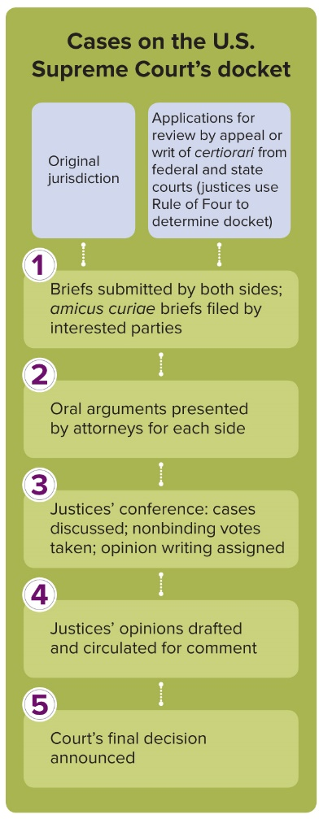
Figure 15.2 Decision Making on the Supreme Court
Cases on the U.S. Supreme Court’s docket may come via the Court’s original jurisdiction; or via applications for review by appeal or writ of certiorari from federal and state courts (justices use Rule of Four to determine docket).
(1) Briefs submitted by both sides; amicus curiae briefs filed by interested parties.
(2) Oral arguments presented by attorneys for each side.
(3) Justices’ conference: cases discussed; nonbinding votes taken; opinion writing assigned.
(4) Justices’ opinions drafted and circulated for comment.
(5) Court’s final decision announced.

Slide 40
Resolving the Legal Dispute: Deciding How to Vote
Judicial scholars offer three decision-making models.
Legal model focuses on legal norms and principles as the guiding force in judicial decision-making.
Those following the attitudinal model follow their policy and ideological preferences when deciding cases.
According to the strategic model, “while justices’ decisions are primarily motivated by policy concerns (thus accepting the attitudinal model), institutional constraints exist that limit the ability of the justices to vote in a manner that is compatible with their attitudes and values in every case.”

Slide 41
Legal Reasoning: Writing the Opinions
Justice assigned the majority opinion will circulate a draft and revise it based on others’ opinions to strengthen it and its support.
Concurring opinions agree with how the majority opinion decides the case but disagree with at least some of the legal arguments or conclusions reached in the majority opinion.
Dissenting opinions not only disagree with these arguments and conclusions but also reject the underlying decision in the case.

Slide 42
Judges as Policymakers
Courts make law—common law—by deciding cases and establishing legal principles that guide future litigants and judges.
Lawmaking function of courts ensures that judges have a powerful role as public policymakers, because the decisions they make profoundly affect not only the parties in the case but also society, the economy, and politics.

Slide 43
From Judicial Review to Judicial Policy Making
Marbury v. Madison (1803).
Plessy v. Ferguson (1896).
Brown v. Board of Education of Topeka, Kansas (1954).
Because of their policy-making role, judges participate in a larger political discourse that goes far beyond the concerns of individual litigants.

Slide 44
Judicial Activism, Living Constitution, Judicial Restraint, and Originalism 1
Judicial activism refers to the courts’ willingness to strike down laws made by elected officials, as well as to step away from past precedents.
Judicial restraint is the belief that the judiciary should not check the power of the democratically elected executive and legislative branches unless their actions clearly violate the Constitution.

Slide 45
Judicial Activism, Living Constitution, Judicial Restraint, and Originalism 2
During the Warren Court (1953 to 1969), the Supreme Court took an activist stance, most notably in rejecting the constitutionality of racial segregation.
Majority treated the Constitution as a living Constitution—taking into consideration changes in social customs and norms.
Judicial activism has been used to further both liberal and conservative causes.
Originalism (textualism): the opposing view that the Constitution means no more or less than it meant to those who wrote it.

Slide 46
Constraints on Judicial Policy Making
Judges and justices face checks and constraints that limit how they decide cases, make law, and act as policymakers.
They are checked or otherwise constrained by other branches of government, lawyers, interest groups, and individual citizens.

Slide 47
Checks and Balances
Article II of the Constitution explicitly gives the legislative and executive branches crucial checks on the structure of the courts.
Congress is granted the power to create all federal courts other than the Supreme Court.
Controls the Supreme Court’s jurisdiction.
Sets the size of the judiciary including the Supreme Court.
Power to impeach federal judges.
President and the U.S. Senate determine who sits on all federal courts.

Slide 48
Public Accountability
Court rarely issues a decision that is completely out of step with the thinking of the majority of the population.
Rulings too far from public opinion risk being ignored.
Courts have little ability to enforce their decisions and must rely on the other branches, where the people have great influence.

Slide 49
Internal Constraints
Law schools train lawyers, and hence judges, to focus on the facts of the case when deciding cases.
Limitations are also imposed by the common-law doctrine of stare decisis.
Federal court judges do not diverge far from Supreme Court precedent, to avoid being overturned.
According to judicial scholar Paul Collins, “Judges are concerned with making good law: attempting to determine the most legally appropriate answer to the controversy.”

Slide 50
Judicial Legitimacy and Public Trust
President Trump’s approach has been atypical in that not only does he express disappointment or disagreement with rulings that are contrary to his preferences, but he has also attacked the legitimacy of the courts who make those rulings.
The courts have always understood that citizens must be confident that the rule of law is the basis of our government and that the courts uphold it fairly.

Slide 51
Review 1
Then—The federal judiciary did not affect the daily lives of citizens due to its limited jurisdiction as established by the Judiciary Act of 1789.
Now—All major policy issues—social, economic, and political—eventually end up in the courts, where judges interpret laws; therefore, courts make policies that affect the daily lives of citizens.

Slide 52
Review 2
Next:
Will calls to reform the term of office of federal judges and justices succeed?
Will the partisan battles over judicial appointments and over the Senate’s advice and consent powers continue?
Will the judiciary retain its legitimacy in our democracy?

Slide 53
End of Main Content
Copyright 2022 © McGraw Hill LLC. All rights reserved. No reproduction or distribution without the prior written consent of McGraw Hill LLC.

Slide 54
Accessibility Content: Text Alternatives for Images

Slide 55
Figure 15.1 Jurisdiction in the Dual Court System - Text Alternative
Return to parent-slide containing images.
In the 50 state court systems, cases may move from the minor trial courts to the major trial courts; the major trial courts to the intermediate appellate courts; and from there, to the state court of last resort.
If a state court case raises questions about federal laws and has been heard by the state court of last resort, it may move to the U.S. Supreme Court.
In the federal court system, cases may move from the U.S. federal district courts (94 courts in all) to a U.S. federal court of appeals (13 courts), and from there may go to the U.S. Supreme Court. Cases may also make it to the Supreme Court from the Court of Military Appeals, the Court of Claims, or the Court of International Trade.
Return to parent-slide containing images.

